Slide 1




THE PROCESS STEPS FOR PAPER CRF AND E-CRF
-ANJALI & ARTI

Slide 2
CONTENT
Defination of CRF
Type of CRF
Preference
Element of CRF
Poorly management CRF Development
Process of paper CRF and E-CRF
CRF Desigining team
Reference

Slide 3


DEFINATION OF CRF
As per ICH GCP,CRF is defined as –A printed paper,Optical or electronic documents are designed to record all the protocol required information to be reported to the sponsor on each trial subject.
Working Defination-CRF Is a tool designed by sponsor to capture the transcription o protocol specific data from source documents to crf

Slide 4
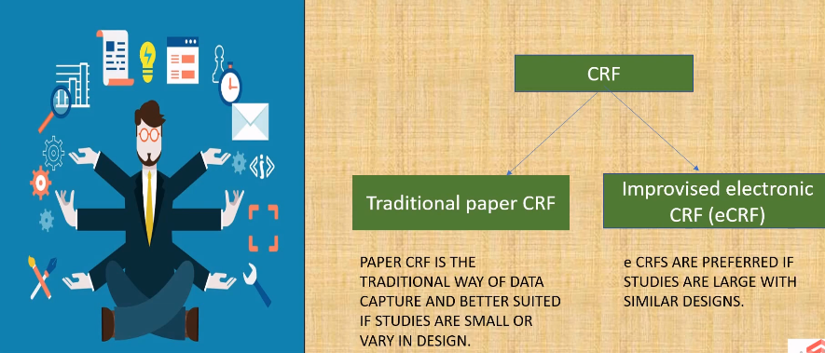
TYPES OF CRF

Slide 5

PAPER CRF
CRF is poorly designed, organized, or printed, there is a greater potential for missing, or incorrect data
CRF pages should be printed single sided
Appropriate font and size
Each CRF page should be clearly linked to the correct site, subject, visit and follow-up interval
Correct usage of CRF page numbers
Use proper date format (e.g., mm/dd/yyyy, dd/MMM/yy) should be clearly stated. Preferance for CDASH DISC format ddMMMyyyy
Time should be collected using 24hour clock (HH:MM)

Slide 6

E-CRF
Provide functionality that helps to avoid potential problems that can occur with paper CRFs (e.g. dates use a pop-up calendar)
Grouping of sites/subjects together thus avoid assigning incorrect site/subject numbers.
Edit checks programmed within the eCRF application validate the data at the point of entry
Capability to tab through fields in a prescribed sequence, avoiding the potential for missed data

Slide 7
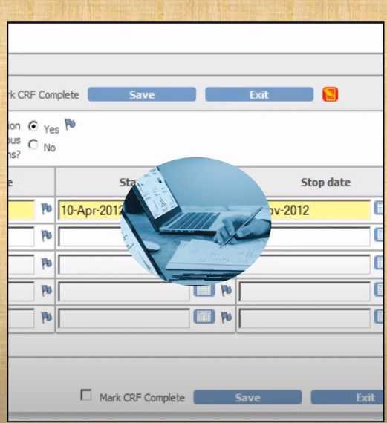
PREFERENCE
E-crf are preferred over paper crf as they are less time- consuming and encourage the sponsors to carry out large multicentric studies at the same time
It is designed with editchecks in such a way that data entery can be done with minimal errors.
The regulatory authorities are readily accepting submissions in which validated electronic data capture (EDC) system are being used

Slide 8
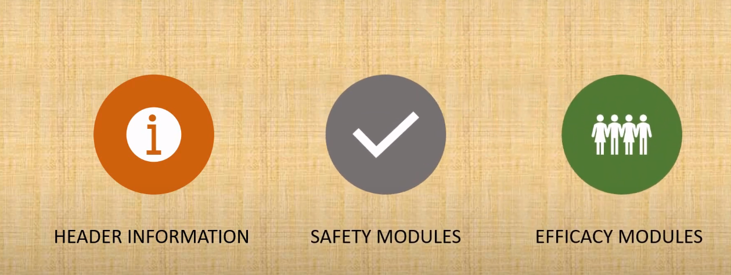
ELEMENTS OF CRF

Slide 9
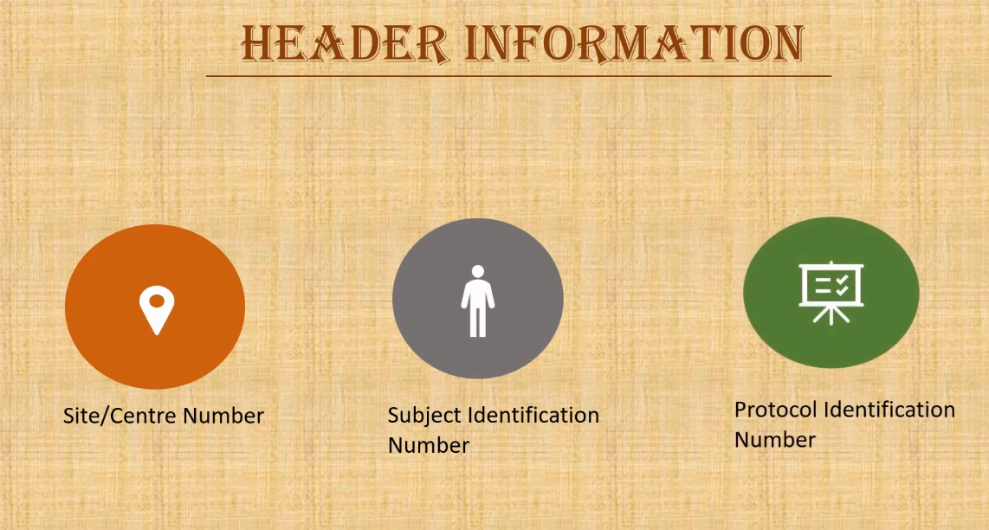

Slide 10
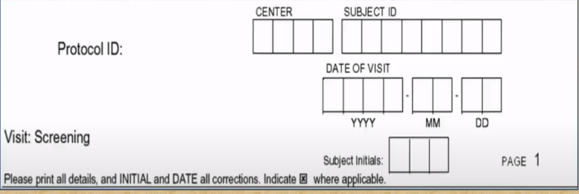
HEADER INFORMATION
De-identification removing the patient name,medicl record number etc.and giving the patient a unique study number used for subjecct identiication
Generated by the system automatically thus ensuring no duplication of crf pages

Slide 11

SAFTEY MODULES
Demographics
Adverse Event
Vital signs
Medical history
Physical examination
Concomitant Medication
Patient Disposition

Slide 12

SAFTEY MODULES
Generally a"Libarary" of standard templates is established to maintain by the sponsors/cro in order to maintain uniformity in the crf design and to save time.
These Modules are also referred as standard CRF templte.
Should be develop in a way,which can be customized as per protocol requirements
These template are of great help while conducting multiples studies in the same therapeutic area.

Slide 13
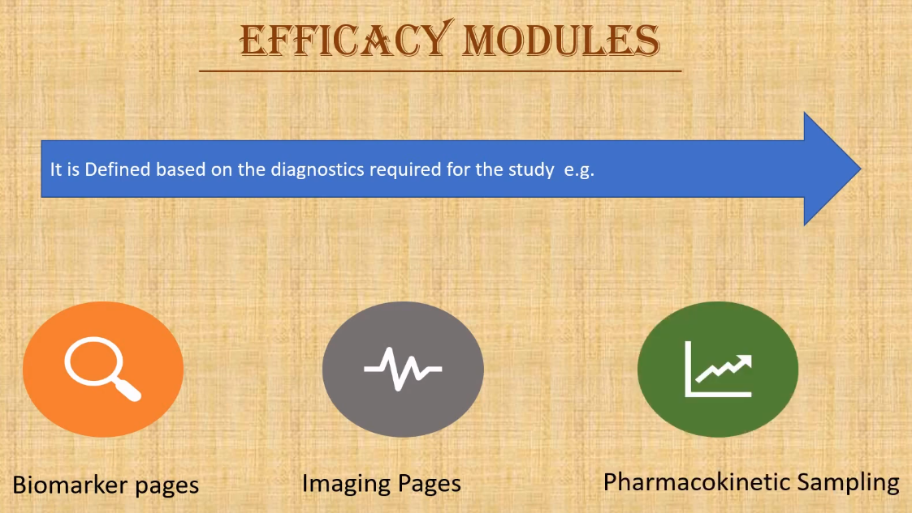

Slide 14
EFFICACY MODULES
Module which captured efficacy data are not unique.
Their design varies depending on the therapeutic area and protocol specification.
Consider developing a therapeutic library of efficacy pages and using them.
Define and identify- Key efficacy end points and additional test for efficay.

Slide 15
POORLY MANAGED CRF DEVELOPMENT(1/2)
Common risk and consequences
Increase the time of CRF creation
Delayed on clinical database creation and go-live
Collection of redundant data
Miss collection of relevant data (i.e. question on CRF not precise
enough, may lead into wrong direction)

Slide 16
POORLY MANAGED CRF DEVELOPMENT(2/2)
Increase number of queries (increase data cleaning timelines)
Create strain on internal resources due to iterative review circles
Increase of the likelihood of database changes and unlock
Increase downstream impact on programming such as remapping of variables

Slide 17
PROCESS OF PAPER CRF AND E-CRF(1/4)
First step into translating the protocol into data
Multidisciplinary approach to designing and developing CRFs
Input from entire study team
Design CRFs to collect the data specified by the protocol
CRF design should be taken into consideration before the protocol is finalized

Slide 18
PROCESS OF PAPER CRF AND E-CRF(2/4)
If Protocol and CRFs are designed concurrently, the quality of both the protocol and the CRFs can be improved through continuous collaboration between these teams
CRFs should not collect data that ultimately will not be used for analysis
Extraneous data can adversely affect overall data quality by drawing the attention of site personnel away from key variables

Slide 19
PROCESS OF PAPER CRF AND E-CRF(3/4)
All data must be attributable to a subject
All CRFs should also contain a provision for investigator signature
Data collected on CRFs will be consolidated for statistical analysis, therefore use standard data structures
Ensure biostatistician review of CRF’s primary and secondary endpoints

Slide 20
PROCESS OF PAPER CRF AND E-CRF(4/4)
Consider developing standardized protocol templates, CRFs, database structures, validation procedures, and reporting tables.
Consider CRF approval, CRF change management and version control
Training on CRF completion and CRF submission to data coordination center
Distribution of CRFs to sites – prior to first subject enrolled

Slide 21
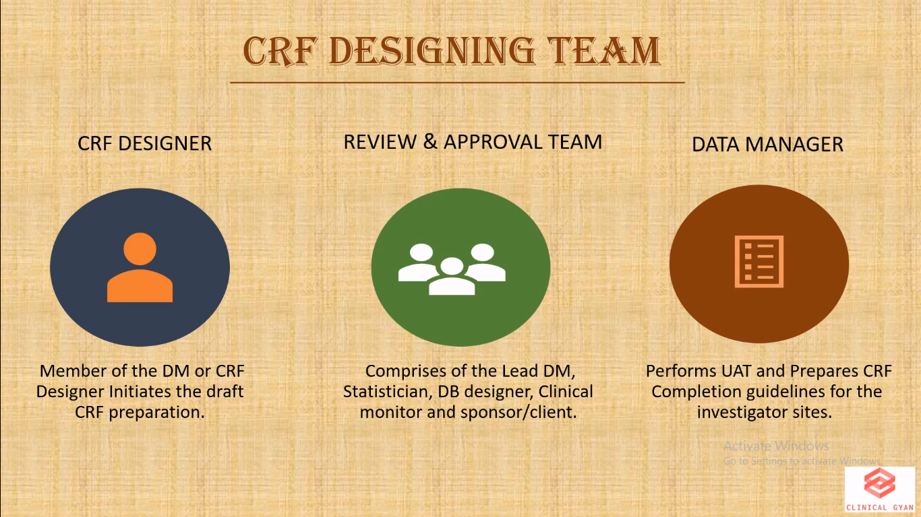

Slide 22

REFERENCE
ICH-GCP (E-6)R2
INA RESPOND
https://www.clinfo.eu/ecrf-development/

Slide 23


